Slide 1
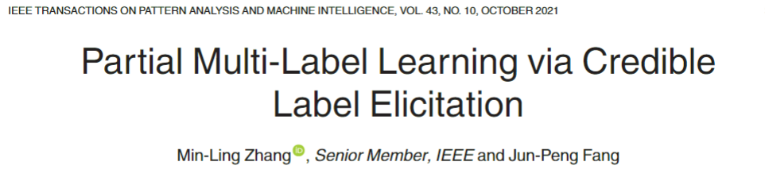
汇报人：项桂巳雨
2022/12/30

Slide 2
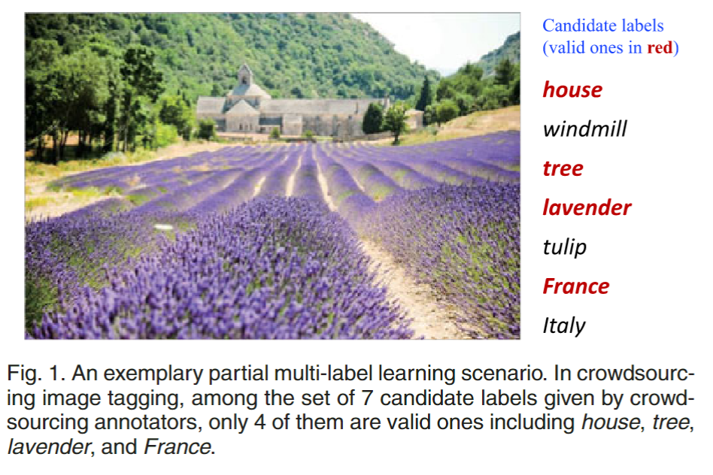
Partial Multi-Label Learning via Credible Label Elicitation
Partial Multi-Label Learning

Slide 3
Partial Multi-Label Learning via Credible Label Elicitation
Partial Multi-Label Learning
Basic Strategy:
treat all candidate labels as groundtruth ones.
choose to disambiguate candidate label set by estimating the confidence of each candidate label being the ground-truth one.

Slide 4
Partial Multi-Label Learning via Credible Label Elicitation
PARTICLE
(PARTIal multi-label learning via Credible Label Elicitation)
1. Credible Label Elicitation
2. Predictive Model Induction
2.1. Virtual Label Splitting
2.2. MAP Reasoning

Slide 5

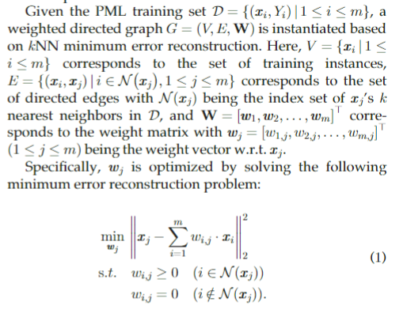
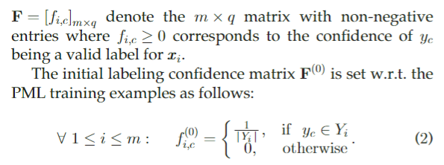

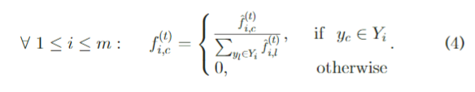
Partial Multi-Label Learning via Credible Label Elicitation
1. Credible Label Elicitation

Slide 6
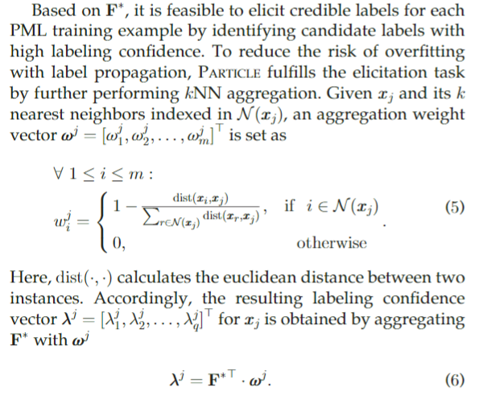
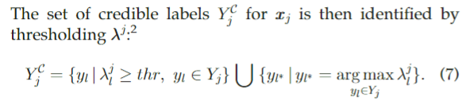
Partial Multi-Label Learning via Credible Label Elicitation
1. Credible Label Elicitation

Slide 7
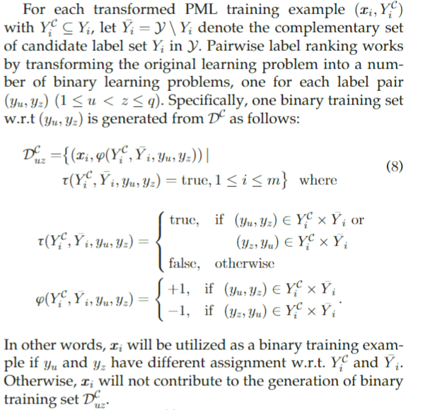
Partial Multi-Label Learning via Credible Label Elicitation
2. Predictive Model Induction
Pairwise label ranking

Slide 8
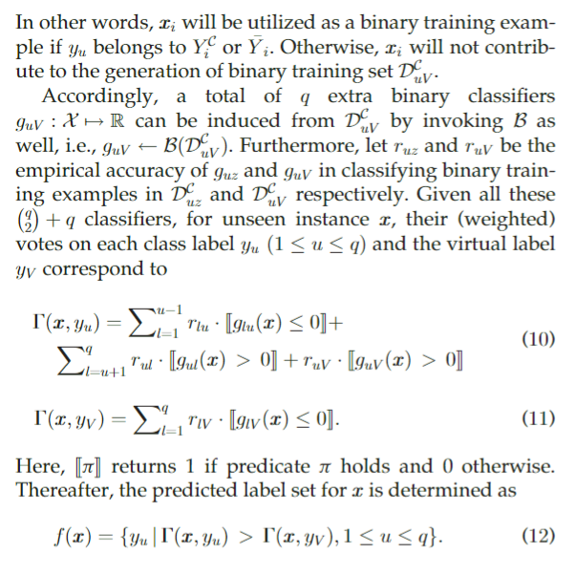
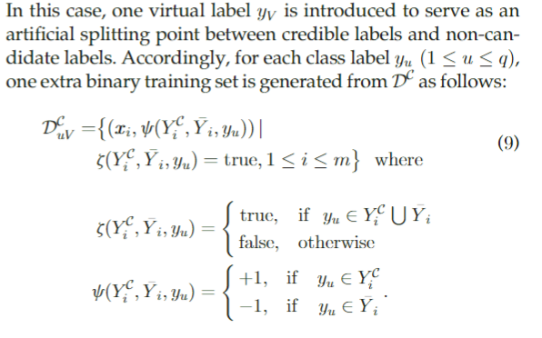
Partial Multi-Label Learning via Credible Label Elicitation
2.1. Virtual Label Splitting

Slide 9
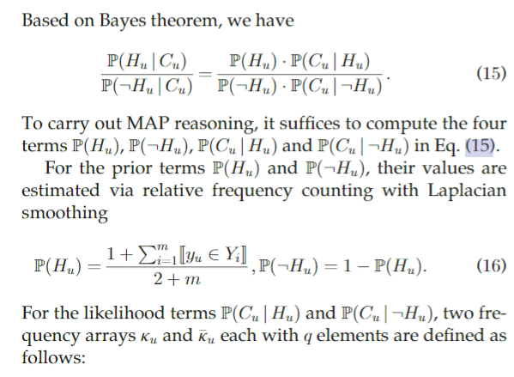
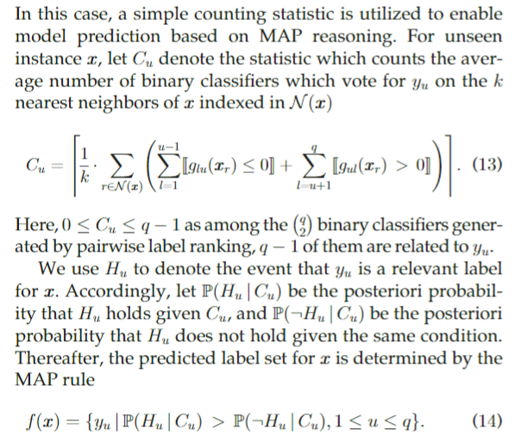
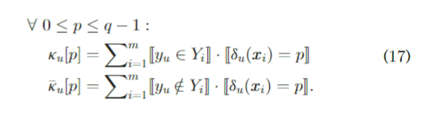
Partial Multi-Label Learning via Credible Label Elicitation
2.2. MAP Reasoning

Slide 10
谢谢大家

